Slide 1
Data Mining

Slide 2
Data Mining
Process of extracting valuable information from a dataset
Identifying patterns and trends in the information
Finding interesting and relevant patterns to support business objectives
Information is stored in
Databases /logs/Big Data
Transform information into useful knowledge
Help Businesses make more informed decisions

Slide 3

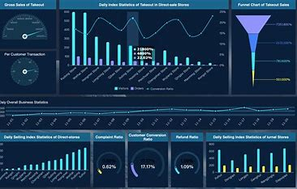
Data Analysis
My favorite part of the data analysis process is finding the hardest problem asking a million questions about it and seeing even if it is possible to get an answer

Slide 4
Advantages
Helps to perform prediction of future trends
Analyze Past Data
Understand current relationships/current situation
Example: correlation between the time someone spends on a website and makes a purchase
Categorize / Select /Group /Filter
Ex: providing mortgage / diagnose people /

Slide 5
Steps

Slide 6
Defining Problem
A problem statement is a concise description of an issue or a gap that a project or a process seeks to address or improve. It clarifies the current and desired states, the impact of the issue, and the possible solutions. It is usually one or two sentences long and unbiased

Slide 7
Understanding Audience
Better understanding of the target audience and the problem
Who are the people engaged,
What are the systems used
Understand how business operates
How people work and why they need this product
Collecting and gathering information

Slide 8
Ask questions
Why
Defining the problem to be solved
Focusing on a real problem not just a symptoms
How
Collaborating with stakeholders and understanding your needs
Performing online research

Slide 9
Important
Ability to understand the client’s requirements
Understand the dataset and relate it to real word

Slide 10

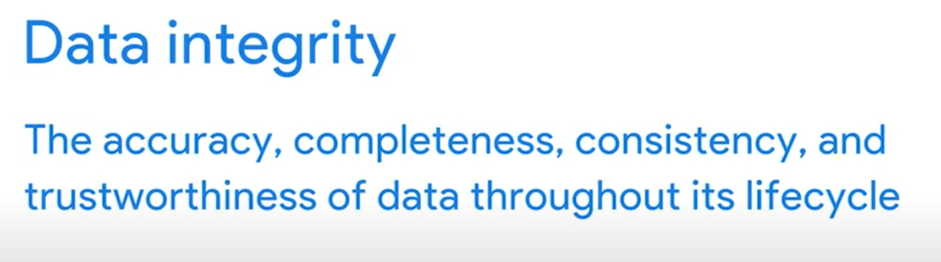
Data Preparation

Slide 11
Data prepare Process
Data Exploring
Data cleaning
Missing Data
Removing outliers
Converting different data types
Data Engineering

Slide 12
Testing and Data Validation
Completed at each step of the data mining process
Insurance data integrity process
Minimizing and reducing potential errors

Slide 13
Performing analysis
Applying data mining techniques and deriving outcomes
Focusing on answering the company objectives
Answering questions that are required by the company
Finding patterns in the data set
Summarizing data
Conclusion

Slide 14
Post analysis - Interoperating Results
Presenting data to the stakeholders: by explaining and presenting the results
to the different levels of the clients
Making sure the outcome is aligned with the customer’s needs
Automating the results by scripting data – in case you can do it
Special skills require
Very tedious task

Slide 15
Techniques

Slide 16
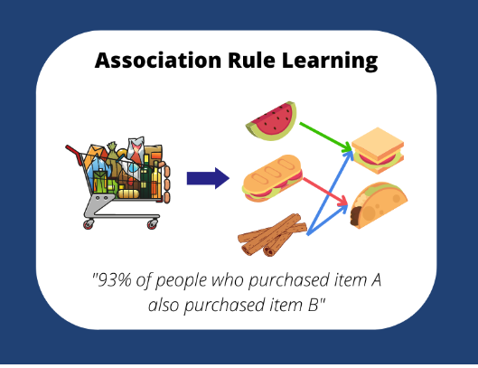
Association
Association – finding relationships / identifying patterns
Correlation between 2 or more items to identify patterns
Customer buys bread and milk
Discover meaningful relationships that correspond to the business primary objectives

Slide 17
Association
Application
Exploring data set
Dashboard Creation
Identifying interesting patterns
Market-based analysis
Recommendation Systems

Slide 18
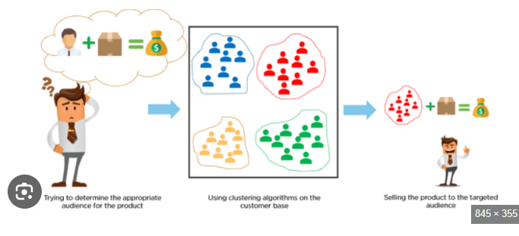
Clustering
Clustering – group individual groups of data to form a structure
Looking at the similarity between items
Looking at the differences between items
Applications
Marketing segmentation
Image processing
Anomaly detection

Slide 19
Clustering
Types
K -means
Hierarchical
Density Based Clustering

Slide 20
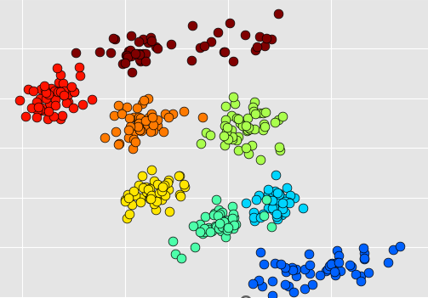
Classification
Predict the category of the class or a given input based on past observations
Process of assigning a given data point to a category or class based on a set of features
Applications
Medical diagnostics / Sentiment Analysis
Spam emails /Credit Risk Assessments

Slide 21
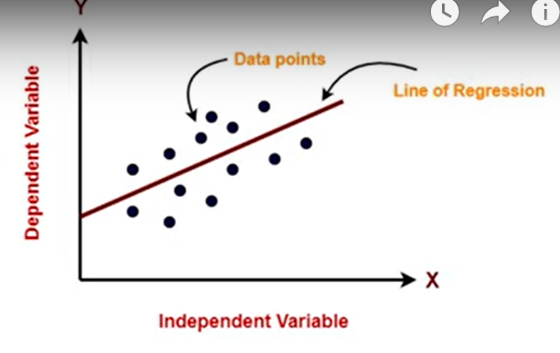
Regression

Slide 22
Regression
Predictions – based on past events you can make predictions about an event
Establishing the relationship between dependent and independent variables
Depended variable – target variable
In the dependent variable - features
Application
Weather – predict the amount of snowfall based on a snowfall amount
Car sell – car sale based on a location

Slide 23
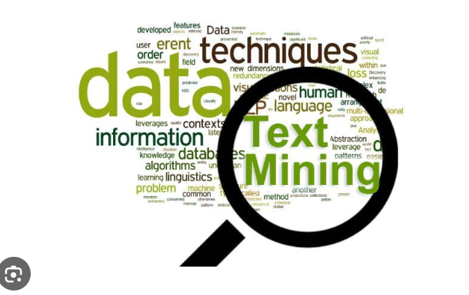
Text Mining
Analyzing and extracting useful information from unstructured data
Applications
Sentiment analysis
Email analysis
Customer reviews
Content Classification

Slide 24
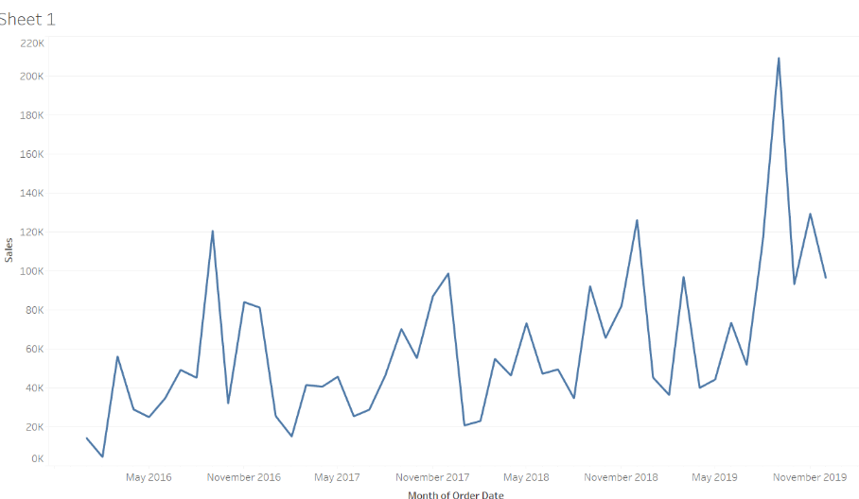
Time Series Analysis
Analyzing and forecasting data points collected over time
One variable is time
One variable is data
Applications
Stock Analysis
Senser Data
Predicting weather patterns

Slide 25
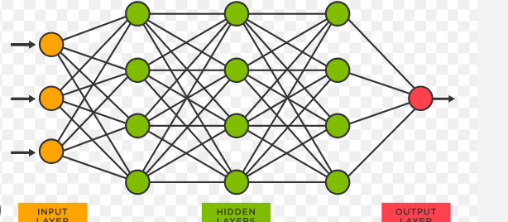
Neural Networking
Interconnecting nodes or neurons
Neurons organized in layers
Ability to learn and generalize complex data
Ability to deal with noise and missing data
Ability to adapt to new data

Slide 26
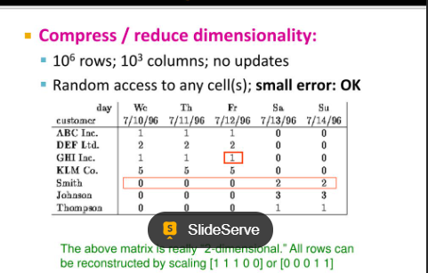
Dimensionally reduction
Reduce the number of features or variables in the dataset
Selecting a subset of the most relevant features to the defined problem

Slide 27
Conclusion

Slide 28
Conclusion
Defining the business problem is a primary step
Data Integrity should be prevailed
Solution depends on a business objectives
Selecting proper clustering techniques for a specific business solution
Summarizing results and presenting them in a meaningful way

